Slide 1
Big Data 101:
Session 5

Slide 2
Week 5 – Topics
AWS Cluster Setup
Data Ingestion

Slide 3
Some Housekeeping

Slide 4
“There are many ways to accomplish what you want to do in Hadoop. Choose the right tool for the right job”
Dave’s Hadoop Law #1:

Slide 5
Data Ingest Options
Not and either/or proposition. Tools can be used together
Pick the right tool for the right job
Kafka
Flume
Storm
Spark Streaming
Nifi
Sqoop
And Many More . . .
(Camus, Samza, Informatica, Talend)

Slide 6
Apache Flume
Apache Flume is a distributed, reliable, and available system for efficiently collecting, aggregating and moving large amounts of log data from many different sources to a centralized data store.
Used for:
Streaming Data Ingest

Slide 7
Apache Flume Concepts
Agent – A (JVM) process that hosts the components through which events flow from an external source to the next destination (hop).
Event – A unit of data flow having a byte payload and an optional set of string attributes.
Source – Consumes events delivered to it by an external source like a web server. The external source sends events to Flume in a format that is recognized by the target Flume source.
Channel – A passive store that keeps the event until it’s consumed by a Flume sink.
Sink – Removes the event from the channel and puts it into an external repository like HDFS or forwards it to the Flume source of the next Flume agent (next hop) in the flow

Slide 8
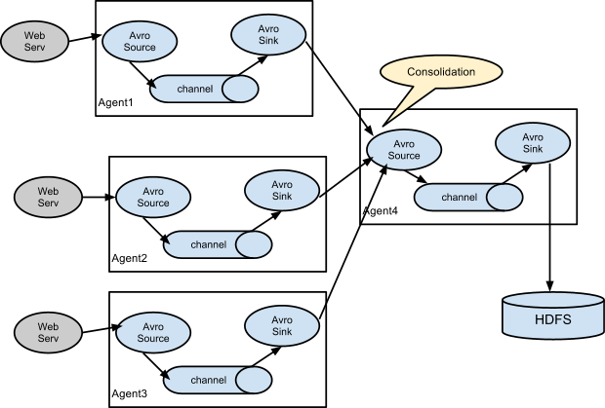
Apache Flume Architecture

Slide 9
Apache Storm
Storm is a distributed real-time computation system for processing large volumes of high-velocity data.
Used for:
Streaming Data Ingest
Stream Processing
Complex Event Processing
Often used with Kafka queue

Slide 10
Apache Storm Concepts
Topology – The logic for a realtime application is packaged into a Storm topology. A Storm topology is analogous to a MapReduce job.
Stream – an unbounded sequence of tuples that is processed and created in parallel in a distributed fashion
Spout – A source of streams in a topology. Generally spouts will read tuples from an external source and emit them into the topology
Bolts – All processing in topologies is done in bolts. Bolts can do anything from filtering, functions, aggregations, joins, talking to databases, and more

Slide 11
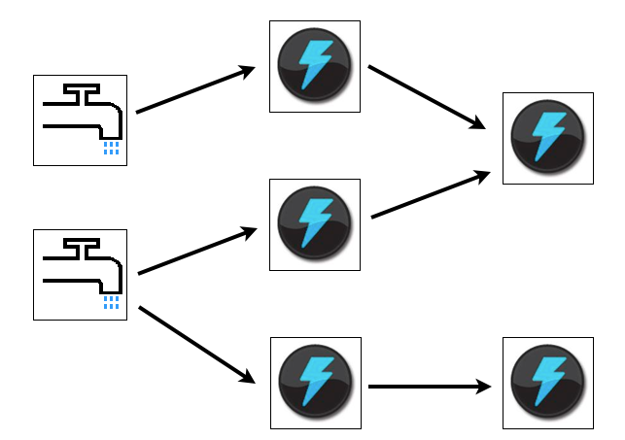
Apache Storm Topology

Slide 12
Apache Kafka
Kafka is a distributed, partitioned, replicated commit log service. It provides the functionality of a messaging system, but with a unique design.
Used for:
Messaging
Log Aggregation
Event Sourcing
Commit Log

Slide 13
Apache Kafka Concepts
Topic – A category or feed name to which messages are published. For each topic, the Kafka cluster maintains a partitioned log
Partition – An ordered, immutable sequence of messages that is continually appended to—a commit log
Producers – Publish data to the topics of their choice.
Consumers – Read data form the topics of their choice.

Slide 14
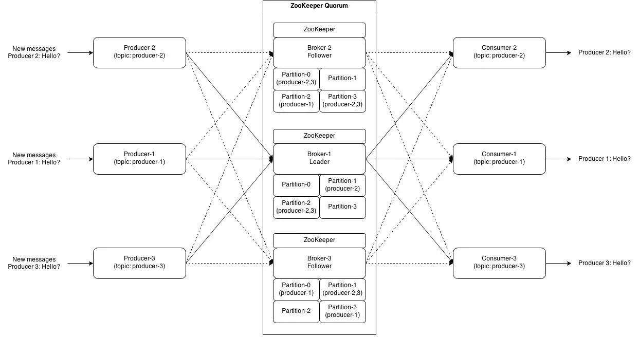
Apache Kafka Architecture

Slide 15
Spark Streaming
Spark Streaming is an extension of the core Spark API that enables scalable, high-throughput, fault-tolerant stream processing of live data streams.
Uses microbatching vs event based streaming
Used for:
Data Ingest
Stream Processing

Slide 16
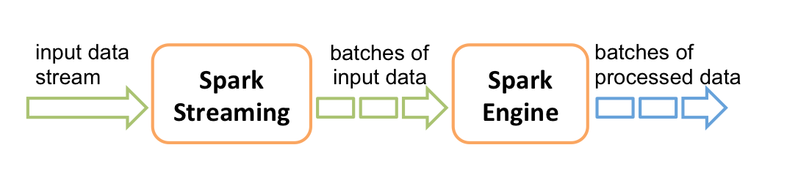
Spark Streaming Architecture

Slide 17
Apache Nifi
Apache Nifi is an easy to use, powerful, and reliable system to process and distribute data. It supports a powerful and scalable directed graphs of data routing, transformation, and system mediation logic.
Used for:
Event Processing
Stream Processing
Internet of Things
Data Ingest
Data Transformation

Slide 18
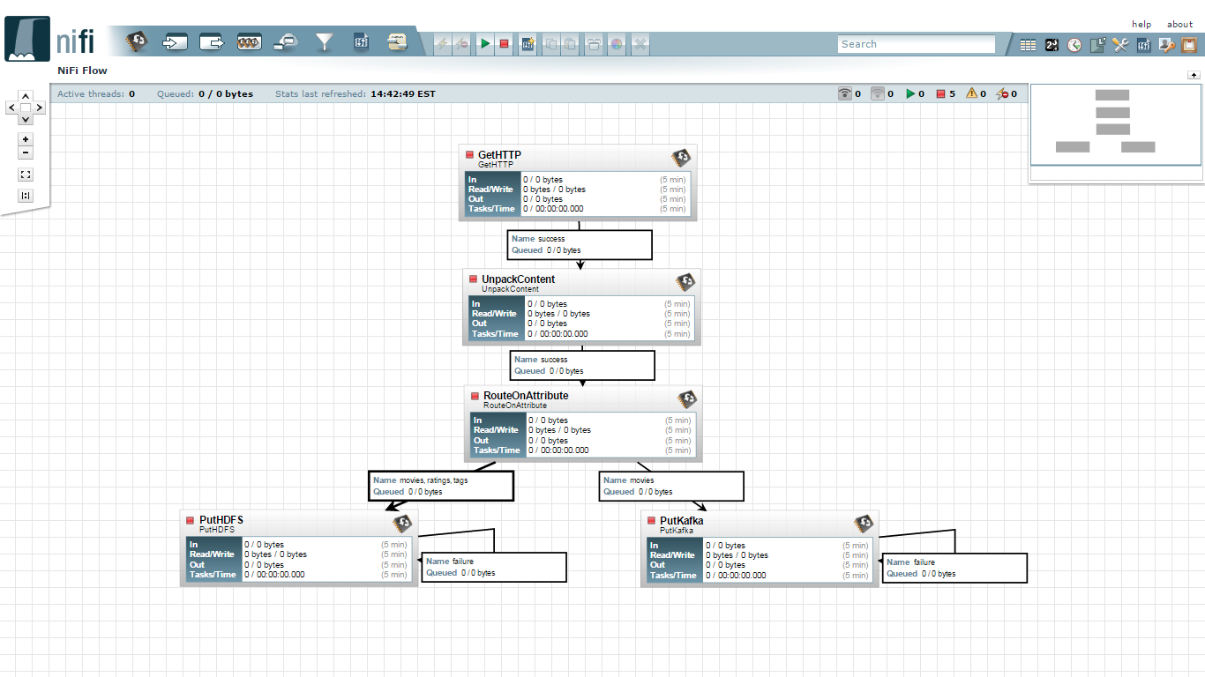
Apache Nifi

Slide 19
Apache Sqoop
Apache Sqoop(TM) is a tool designed for efficiently transferring bulk data between Apache Hadoop and structured datastores such as relational databases.
Used for:
Bi-directional data transfer between RDBMS and Hadoop

Slide 20
Data Organization

Slide 21
HDFS Data Organization
/intent
/category
/application
/dataset
/partitions
/files
Example:
/data/fraud/txs/2012/20120101-00.avro
/group/research/model-17/training-txs/part-00001.avro
/user/esamer

Slide 22
Data Pipelines
Event
headers: {
app: 1234,
type: 1234,
ts: <epoch>
},
body: <bytes>
HDFS
/data/ops/syslog/2012-01-01
/data/web/core/2012-01-01
/data/web/retail/2012-01-01
Syslog
Events
Flume Agent
/data/pos/NY/1621/2012-01-01
/data/pos/WA/2376/2012-01-01
Flume
(Channel 1)
Sqoop
(Job 1)
Web App
Database
Application
Events
/data/wdb/<database>/<table>
Flume
(Channel 2)
Clickstream
Events
/data/edw/<database>/<table>
EDW
Sqoop
(Job 2)
Flume
(Channel 3)
Point of Sale
Events
Relational Data
Streaming Data

Slide 23
Structure Data in Tiers
Develop a clear hierarchy of source and derived relationships
Best Practice towards proper data lineage
Examples:
Tier-0: Raw data from source systems
Tier-1: Derived from Tier-0 data. Cleansed and normalized
Tier-2: Derived form Tier-1 data. Aggregated and Summarized

Slide 24
Tiered Data Pipeline Example
HDFS (Tier 0)
HDFS (Tier 1)
/data/ops/syslog/2012-01-01
Sessionization
/data/reporting/session-day/2012-01-01
/data/web/core/2012-01-01
/data/web/retail/2012-01-01
/data/reporting/events-hour/2012-01-01
Event Report Aggregation
/data/pos/NY/1621/2012-01-01
/data/pos/WA/2376/2012-01-01
/data/wdb/<database>/<table>
Inventory Reconciliation
Event Report Summation and Rollup
/data/edw/<database>/<table>
HDFS (For Export)
HDFS (Tier 2)
/data/reporting/session-day/2012-01-01
/data/reporting/events-day/2012-01-01

Slide 25
Lambda Architecture
Batch Layer
Hadoop – Map Reduce
Serving Layer
Batch Views
Hive Metastore
Pre-Compute View 1
Tier-0 Data
Batch Recompute
(MapReduce)
Pre-Compute View 2
Flume
Streaming Data Source
Pre-Compute View n
Streaming Data Source
Streaming Data Source
Query
Impala or Drill
Sync'd Data
Sync'd Algorithm
Speed Layer
Storm
Realtime Views
hBase
Flume
Realtime View 1
Process Stream Data
RealTime Functions
Realtime View 2
Realtime View n

Slide 26
Exercises

Slide 27


Real Time Ingest Scenario Architecture
Data Lake
Flume Memory Channel 1
Flume HDFS Sink
Event Source
Flume Netcat Source
Flume Memory Channel 2
Flume Hive Sink

Slide 28


Batch Ingest Scenario Architecture
Dealer Uploads XML Log
Dealer
File Drop
FileWatcher via WebHDFS
Data Lake
FTP

Slide 29
Homework
Complete EC2 Cluster Buildout
Complete the Flume Assignment (Posted Online)
Complete the HDP Storm Tutorial – http://hortonworks.com/hadoop-tutorial/processing-streaming-data-near-real-time-apache-storm/
Complete the HDP Kafka Tutorial – http://hortonworks.com/hadoop-tutorial/simulating-transporting-realtime-events-stream-apache-kafka/

Slide 30
Additional Sources
Apache Storm Docs – http://storm.apache.org/documentation.html
Apache Flume – https://flume.apache.org/
Apache Kafka – https://kafka.apache.org
Apache Spark Streaming – http://spark.apache.org/docs/latest/streaming-programming-guide.html
Apache Sqoop – http://sqoop.apache.org/
Apache Nifi – https://nifi.apache.org/

